Slide 1
Bahan Rapat
Meeting Material
Rapat Umum Pemegang Saham Tahunan dan Rapat Umum Pemegang Saham Luar Biasa Annual General Meeting of Shareholders and Extraordinary General Meeting of Shareholders
PT Mitrabahtera Segara Sejati Tbk.
16 Juni 2022 / June 16th, 2022

Slide 2
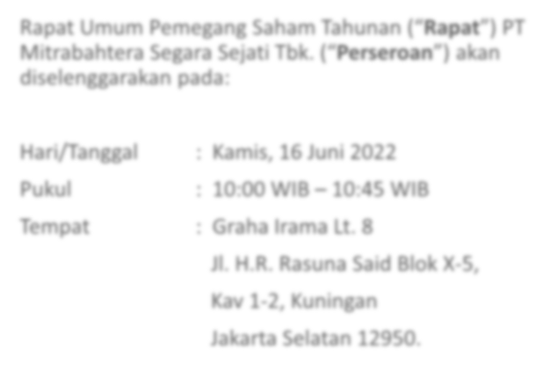
RAPAT UMUM PEMEGANG SAHAM TAHUNAN
ANNUAL GENERAL MEETING OF SHAREHOLDERS
Rapat Umum Pemegang Saham Tahunan (“Rapat”) PT Mitrabahtera Segara Sejati Tbk. (“Perseroan”) akan diselenggarakan pada:
Annual General Meeting of Shareholders (“Meeting”) PT Mitrabahtera Segara Sejati Tbk. (“Company”) will be held on:
: Thursday, June 16th, 2022
: 10:00 AM – 10:45 AM
: Graha Irama 8th Floor
Jl. H.R. Rasuna Said Block X-5 Kav 1-2, Kuningan
Jakarta Selatan 12950.
Hari/Tanggal Pukul Tempat
: Kamis, 16 Juni 2022
: 10:00 WIB – 10:45 WIB
: Graha Irama Lt. 8
Jl. H.R. Rasuna Said Blok X-5,
Kav 1-2, Kuningan
Jakarta Selatan 12950.
Day/date Time Venue

Slide 3
MATA ACARA RAPAT
AGENDA OF THE MEETING
MATA ACARA PERTAMA
FIRST AGENDA
Persetujuan laporan tahunan Perseroan, laporan pertanggungjawaban Direksi dan laporan tugas pengawasan Dewan Komisaris Perseroan untuk tahun buku yang berakhir pada tanggal 31 Desember 2021.
Penjelasan: Mata acara ini dilaksanakan berdasarkan ketentuan Pasal 21 ayat 3 anggaran dasar Perseroan dan Pasal 69 dan 78 Undang-undang No. 40 Tahun 2007 (“UUPT”), laporan tahunan Perseroan, laporan pertanggungjawaban Direksi Perseroan dan laporan tugas pengawasan Dewan Komisaris Perseroan harus mendapatkan persetujuan Rapat. Oleh karenanya, Perseroan mengajukan mata acara dimaksud.
Approval of annual report of the Company, statement of accounts of the Board of Directors of the Company and the supervisory of the Board of Commissioners of the Company for the financial year ended on 31 December 2021.
Description: This agenda is carried out based on Article 21 paragraph 3 of the articles of associations of the Company and Articles 69 and 78 of Law No. 40 of 2007 on Limited Liability Companies (“Company Law”), the annual report of the Company, statement of accounts of the Board of Directors of the Company and the supervisory of the Board of the Commissioners of the Company must obtain an approval from the Meeting. Therefore, the Company has proposed the above agenda.
MATA ACARA KEDUA
SECOND AGENDA
Pengesahan laporan keuangan Perseroan yang memuat neraca dan perhitungan laba rugi Perseroan untuk Tahun Buku yang berakhir pada tanggal 31 Desember 2021.
Penjelasan: Mata acara ini dilaksanakan berdasarkan ketentuan Pasal 21 ayat 3 anggaran dasar Perseroan dan Pasal 69 UUPT. Laporan Keuangan yang memuat Neraca dan Perhitungan Laba Rugi Perseroan untuk Tahun Buku yang berakhir 31 Desember 2021 harus mendapatkan pengesahan dari Rapat. Oleh karenanya, Perseroan mengajukan mata acara dimaksud.
Approval of the financial statement of the Company which includes the balance sheet and profit and loss of the Company for the financial year ended on 31 December 2021.
Description: This agenda is carried out based on Article 21 paragraph 3 of the articles of associations of the Company and Article 69 Company Law, the financial statement which includes balance sheet and profit and loss of the Company for the year ended on 31 December 2021 must obtain approval from the Meeting. Therefore, the Company has proposed the above agenda

Slide 4
MATA ACARA RAPAT
AGENDA OF THE MEETING
MATA ACARA KETIGA
THIRD AGENDA
Persetujuan penggunaan laba bersih Perseroan untuk tahun buku yang berakhir pada tanggal 31 Desember 2021.
Penjelasan: Mata acara ini dilaksanakan berdasarkan ketentuan Pasal 22 ayat 1 anggaran dasar Perseroan dan Pasal 70 dan 71 UUPT, penggunaan laba bersih Perseroan untuk tahun buku yang berakhir tanggal 31 Desember 2021, harus mendapatkan persetujuan dari Rapat. Oleh karenanya, Perseroan mengajukan mata acara dimaksud.
Approval on the use of net profits of the Company for the financial year ended on 31 December 2021.
Description: This agenda is carried out based on Article 22 paragraph 1 articles of associations of the Company and Articles 70 and 71 of the Company Law, the use of the Company’s net profits for the financial year ended on 31 December 2021 must obtain approval from the Meeting. Therefore, the Company has proposed the above agenda.
MATA ACARA KEEMPAT
FOURTH AGENDA
Penunjukan serta penetapan akuntan publik untuk melakukan audit atas laporan keuangan Perseroan untuk tahun buku yang berakhir pada tanggal 31 Desember 2022.
Penjelasan: Mata acara ini dilaksanakan berdasarkan ketentuan Pasal 21 ayat 3 anggaran dasar Perseroan dan Pasal 69 UUPT. Laporan Keuangan yang memuat Neraca dan Perhitungan Laba Rugi Perseroan untuk Tahun Buku yang berakhir 31 Desember 2021 harus mendapatkan pengesahan dari Rapat. Oleh karenanya, Perseroan mengajukan mata acara dimaksud.
Appointment of the public accountant to conduct an audit for the Company’s
financial statement for the financial year ended on 31 December 2022.
Description: This agenda is carried out based on Article 11 paragraph 5 point C of the articles of associations of the Company, the appointment of the public accountant to conduct an audit for the Company’s financial statement for the financial year ended on 31 December 2022 outlined in the Meeting. Therefore, the Company has proposed the above agenda

Slide 5
MATA ACARA RAPAT
AGENDA OF THE MEETING
MATA ACARA KELIMA
FIFTH AGENDA
Penentuan besaran remunerasi bagi anggota Dewan Komisaris dan
Direksi Perseroan untuk tahun 2022.
Penjelasan: Mata acara ini dilaksanakan berdasarkan ketentuan Pasal 15 ayat 14 dan Pasal 18 ayat 12 anggaran dasar Perseroan serta Pasal 96 ayat 1 dan Pasal 113 UUPT, penentuan remunerasi bagi anggota Dewan Komisaris dan Direksi Perseroan untuk Tahun 2021 harus memerlukan persetujuan Rapat. Oleh karenanya, Perseroan mengajukan mata acara dimaksud.
Determination of the remuneration of the members of the Board of Commissioners and the Board of Directors of the Company for the year 2022.
Description: This agenda is carried out based on Article 15 paragraph 14 and Article 18 paragraph 12 of associations of the Company and Article 96 paragraph 1 and Article 113 Company Law, the determination of remuneration for members of the Company's Board of Commissioners and Directors for 2021 must obtain approval of a Meeting. Therefore, the Company has proposed the above agenda.

Slide 6
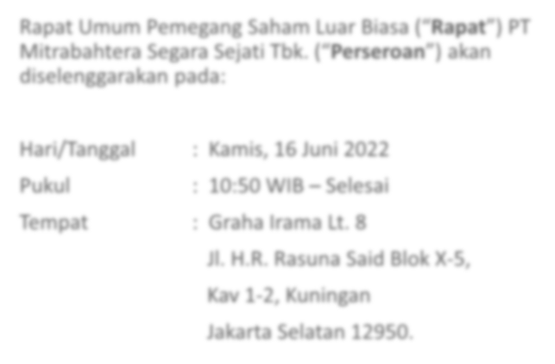
RAPAT UMUM PEMEGANG SAHAM LUAR BIASA
EXTRAORDINARY GENERAL MEETING OF SHAREHOLDERS
Rapat Umum Pemegang Saham Luar Biasa (“Rapat”) PT Mitrabahtera Segara Sejati Tbk. (“Perseroan”) akan diselenggarakan pada:
Extraordinary General Meeting of Shareholders (“Meeting”) PT Mitrabahtera Segara Sejati Tbk. (“Company”) will be held on:
: Thursday, June 16th, 2022
: 10:50 AM – Finish
: Graha Irama 8th Floor
Jl. H.R. Rasuna Said Block X-1 Kav 1-2, Kuningan
Jakarta Selatan 12950.
Hari/Tanggal Pukul Tempat
: Kamis, 16 Juni 2022
: 10:50 WIB – Selesai
: Graha Irama Lt. 8
Jl. H.R. Rasuna Said Blok X-1,
Kav 1-2, Kuningan
Jakarta Selatan 12950.
Day/date Time Venue

Slide 7
MATA ACARA RAPAT
AGENDA OF THE MEETING
MATA ACARA
AGENDA
Persetujuan atas perubahan beberapa ketentuan dalam Anggaran Dasar Perseroan.
Penjelasan: Perseroan akan mengusulkan dalam RUPSLB untuk memperoleh persetujuan atas perubahan anggaran dasar Perseroan dan memberikan kewenangan kepada Direksi Perseroan untuk Menyusun serta menyatakan kembali seluruh anggaran dasar Perseroan.
Approval of Adjustment to several provisions of the Company’s Article of Association.
Description: The Company will propose in the EGMS to obtain approval for adjustment to the articles of association of the Company and authorize the Board of Directors of the Company to prepare and restate all the articles of association of the Company
THE PROPOSED AMENDMENT TO THE COMPANY'S ARTICLES OF ASSOCIATION
Article 14 (Code of Conduct, Quorum, Voting Rights and Decisions at the General Meeting of Shareholders)
Adjustment of provisions related to the quorum of attendance and decision making of the Meeting on the agenda of the General Meeting of Shareholders.
Article 15 (Board of Directors)
Adjustment to several provisions, including the number of members and the term of office of members of the Board of Directors.
Article 16 (Duties, Responsibilities and Authorities of the Board of Directors)
Adjustment of provisions related to limiting the authority of members of the Board of Directors
USULAN PERUBAHAN ANGGARAN DASAR PERSEROAN
Pasal 14 (Tata Tertib, Kuorum, Hak Suara dan Keputusan dalam Rapat Umum Pemegang Saham)
Penyesuaian ketentuan terkait kuorum kehadiran dan pengambilan keputusan Rapat atas agenda Rapat Umum Pemegang Saham.
Pasal 15 (Direksi)
Penyesuaian beberapa ketentuan, antara lain terkait jumlah anggota dan masa jabatan anggota Direksi.
Pasal 16 (Tugas, Tanggung Jawab dan Wewenang Direksi)
Penyesuaian ketentuan terkait pembatasan wewenang anggota Direksi.

Slide 8
MATA ACARA RAPAT
AGENDA OF THE MEETING
USULAN PERUBAHAN ANGGARAN DASAR PERSEROAN
THE PROPOSED AMENDMENT TO THE COMPANY'S ARTICLES OF ASSOCIATION
Article 17 (Board of Directors Meeting)
Adjustment of Provisions related to determination of the decision-making quorum for the Board of Directors meeting.
Article 18 (Board of Commissioners)
Adjustment of provisions, including the number of members and the tenure of the members of the Board of Commissioners.
Article 20 (Board of Commissioners Meeting)
Adjustment of Provisions related to determination of the decision-making quorum for the Board of Commissioners meeting.
Pasal 17 (Rapat Dewan Direksi)
Penyesuaian ketentuan mengenai penetapan kuorum pengambilan.
Pasal 18 (Dewan Komisaris)
Penyesuaian beberapa ketentuan, antara lain terkait jumlah anggota dan masa jabatan anggota Dewan Komisaris.
Pasal 20 (Rapat Dewan Komisaris)
Penyesuaian ketentuan mengenai penetapan kuorum pengambilan keputusan rapat Dewan Komisaris.

